Slide 1
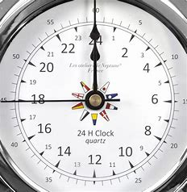
The ecology clock – spring and summer
Dusk bat survey
Dawn bat survey
Great crested newt survey
Breeding bird survey
ECoW – night shift
Business hours / ECoW/ daytime survey work

